Slide 1

Transitioning to Tech
Launching a product

Slide 2
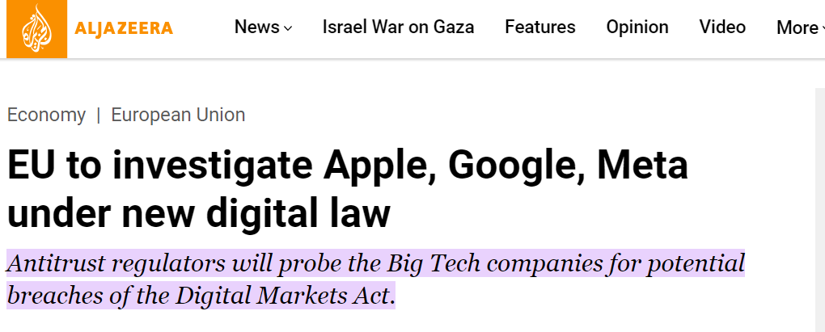
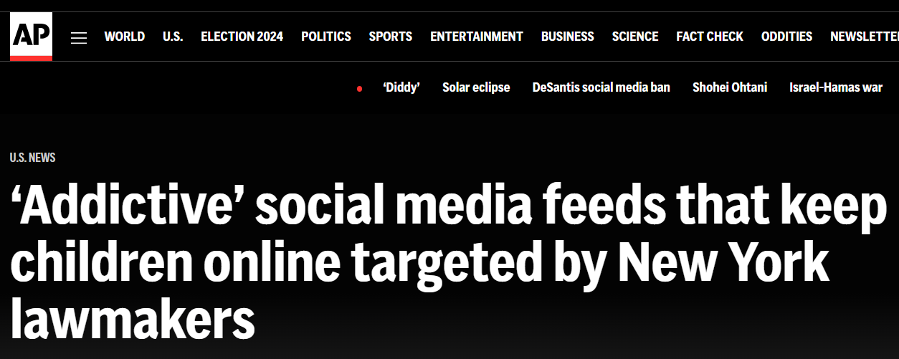
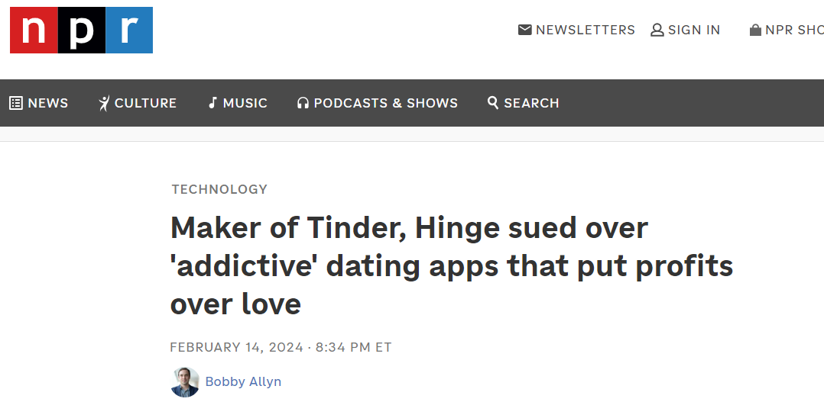
In The News…
  EU may sue large tech for stifling competition
  The algorithm lawsuits have begun

Slide 3
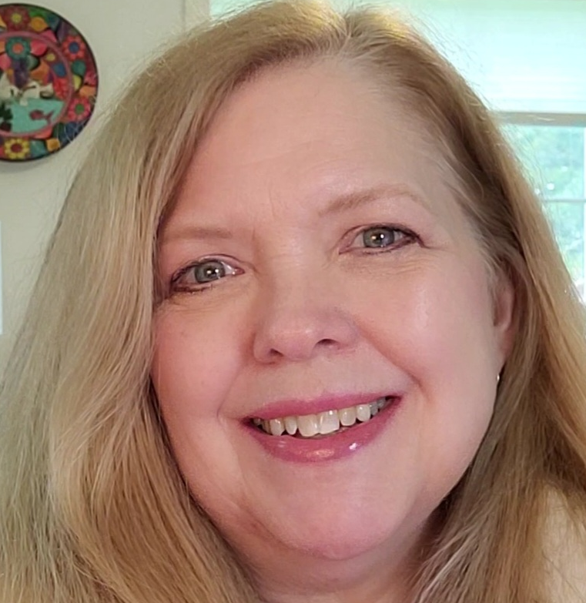
Welcome to Transitioning to Tech
Curate Your Path to a Tech Career
  Focus your efforts; do it in the right order
Finding the signal amid the noise
  Avoid time wasters; forge your critical route
Expertise
  30 years combined tech/learning and development – let me be your tech sherpa
Services
  Knowledge base, tools, community, coaching
Assess Skills
Ideal Roles
Learn
Experience / Portfolio
Brand Your Job Search
Obtain Job
Navigate Career

Slide 4
Agenda
Planning a product – Agile tools for actualizing a concept
What portable skills can you bring? What gaps do you have?
Apply concepts: Play the “ScreenGig Factory Game”:
  Work begins at the Screengig Factory
  We need a high level plan for getting an early prototype out the door
Discussion

Slide 5
Tonight’s Topic – Planning a Product Launch
Why this topic?
  Impacts any software role
  Whole team has involvement
Planning and Learning
  Need a plan to incrementally create, iterating on feedback and product success

Slide 6
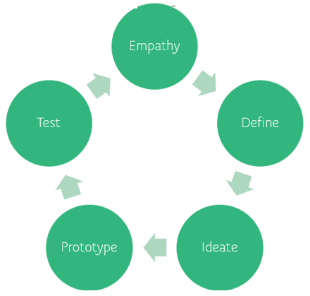
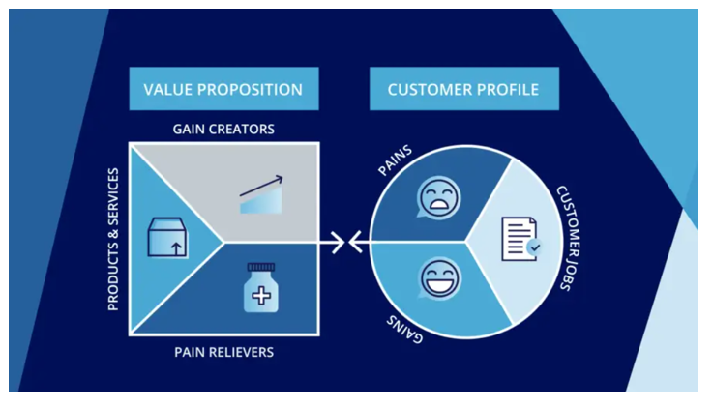

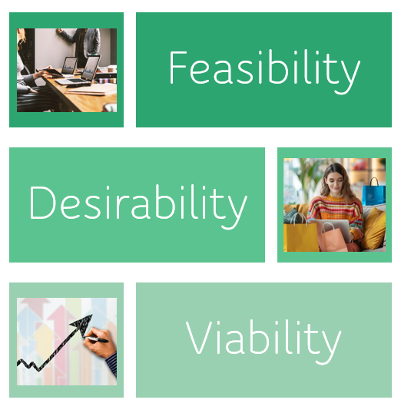
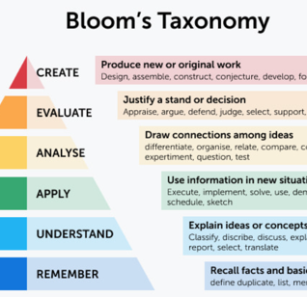

Product Value Quick Review
Design Thinking
How Might We?
Value Prop Canvas
Business Model Canvas
Bloom’s Skill Assessment
Screen Gig Sim

Slide 7
Agile Manifesto
Agile Manifesto History
Created at the Snowbird Ski Resort in Utah February 11-13, 2001
Acknowledged the failures of long term, waterfall project plans
Declared these principles:
“Individuals and interactions over processes and tools
Working software over comprehensive documentation
Customer collaboration over contract negotiation
Responding to change over following a plan
That is, while there is value in the items on
the right, we value the items on the left more.”

Slide 8
Why?
50-80% Software projects fail
Software is a nascent technology – volatile, ever changing, hyper competitive
Old school waterfall:
  1000 pages of specs
  2 year development cycle ‘in a vacuum’
  Cost overruns with scope creep
  Lost opportunity to adapt to the market

Slide 9
Core strengths – Iterative Feedback Loop
Build
Test “Feedback”
Design

Slide 10
Methodologies – Most Popular
12 Agile Methods
Advantage: Iterative development, transparency, adaptability Roles: Scrum Master, Development Team, Keywords: Sprint, Daily Standup, Backlog | Advantage: Iterative development, transparency, adaptability Roles: Developer, Tester, Customer, Coach Keywords: Pair Programming, Test-Driven Development, Continuous Integration | Advantage: Faster feedback, reduced risk, faster time-to-market Roles: Kanban Manager, Team Lead, Project Manager Keywords: Visual Board, Work in Progress (WIP)
Scrum | Extreme Programming (XP) | Kanban
Advantage: Scalability, alignment across multiple teams and projects Roles: Release Train Engineer, Product Manager, Agile Team Keywords: Program Increment, Portfolio Kanban | Advantage: Collaboration, automation, faster time-to-market Roles: DevOps Engineer, Site Reliability Engineer, Software Developer Keywords: Automation, Continuous Delivery | Advantage: Flow efficiency, flexibility, continuous improvement Roles: Build Engineer, Release Manager, DevOps Engineer Keywords: Continuous Integration, Continuous Deployment
SAFe-Scaled Agile Framework | DevOps – Not Agile Per Se | CI/CD – Agile Helper

Slide 11
Product Roadmaps
Product Roadmaps
A product roadmap is a high level plan that delivers on product value but allows for learning, feedback and change
High level vision
Why and When
Provides an Execution Plan, Focusing on the event horizon

Slide 12
Product Roadmap Example
 | Q1 | Q2 | Q3 | Q4
Design UI v1
Build Tech Stack
Login Page
User Profile
Create Destination Pages
Release 1.0 MVP

Slide 13
MVPs
Minimal Viable Product
Minimal Viable Products – what’s the least we can do to get a product created?
  Get early feedback
  Pivot if product is failing
  Expose and mitigate risk early
They don’t have to be a fully automated solution
  Low budget “bets”
  Allow for learning before solving the entire problem
Examples:
  “Self driving” user experience feedback (true story!)
  Fake website “interactions” powered by real people – chat bot, “automated emails”

Slide 14
Tooling
Information Radiator
Information Radiator – Context, Actual to Plan, Quick Status, Team Focus
Software:
  Rally
  Jira
    House roadmaps
    Stories and epics (next up)
    Reports such as burn rate, velocity

Slide 15
Initiative, Epics, Stories, Tasks
Overview of Sagas, Epics, Stories
Initiative (Saga)
Epic
Epic
Story
Story
Story
Story
Story
Story
Story
Story
Story
Each organization has their own rules, timeframes, and ways of splitting up the work
Atomize development work – associate it to a product or a major effort
Stories are the most important for the development team

Slide 16
Story Format
Story Format
Stories describe the user’s desired solution and why it’s important
An atomic unit of user value
As a __(role/persona)
I want __(desired features)
So that __(goal)

Slide 17
Iterations, Ceremonies
Agile Ceremonies
A potential releasable shipment of software is released every 1-3 weeks
Working code that delivers incremental value, even if it’s to learn or expose risk early
Provides an opportunity for feedback
Ceremonies within the iteration (warning-terms can vary):
  Iteration or Sprint Planning
  Daily Stand up
  Backlog Grooming
  Show and Tell or Demo
  Retrospective
Wash, rinse and repeat – defining a self learning, repeatable and sustainable method for delivering software

Slide 18


Time to play – Welcome to the Factory!

Slide 19
Meet Our Team
12 Agile Methods
Product Owner | Product Manager | Data Scientist | Tech Anchor
Founder/Business Lead | Product Designer | Release Engineer | Front End Developer
 | Quality Assurance |  | Back End Developer

Slide 20

Plan our Travel App
12 Agile Methods
MVPs – what could we do fast and cheap?
Roadmap – Q1
Iterations – cadence for team
Backlogs - groom
Stories – write some

Slide 21
Stories
12 Agile Methods
As a….
I want to…
So that….
Let’s define the question

Slide 22
Being Agile
Agility methods, terms, and roles have a lot of cross over
Your organization will have it’s flavor
Stay open and flexible through your career
Remember the original manifesto – adapt the attitude of agility to the situation
Vs. Doing Agile

Slide 23
Roadmap
12 Agile Methods
What is our roadmap?
What are some epics?
What iteration cadence would work for us?

Slide 24
Let’s Discuss!
12 Agile Methods
Have you seen this in your experience?
How might this inform your work?
What part of the product work would you be interested in?
How’d we do on our curated roadmap?
Skills Assessment
Ideal Roles
Learning
Experience (Credentials/Portfolio)
Brand / Job Search Prep
Obtain Job
Navigate Career

Slide 25
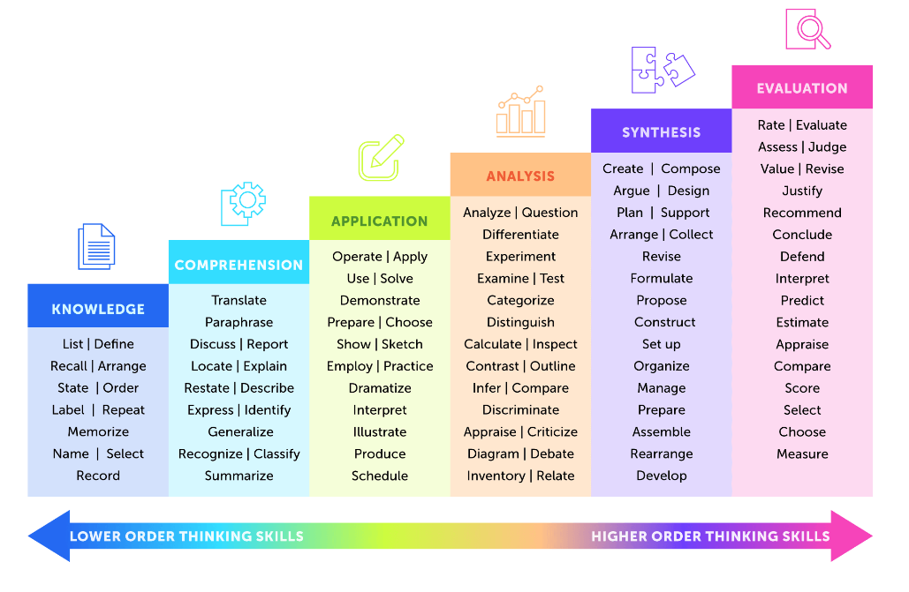
Skills You Need for Agile Development
Technical Skills:
  Proficiency in programming languages and frameworks relevant to the project.
  Understanding of software development principles, methodologies, and best practices.
  Familiarity with version control systems (e.g., Git) and issue tracking tools (e.g., Jira).
  Knowledge of testing techniques and tools for both automated and manual testing.
  Ability to work with agile development tools such as Agile Planning Boards,
  CI/CD pipelines, and collaboration platforms.
Collaboration and Communication
Adaptability and Flexibility
Problem-Solving and Critical Thinking
Time Management and Organization
Continuous Learning and Improvement
Empathy and Emotional Intelligence

Slide 26
Skill by Role
Skill | Agile Team Roles That Most Need This Skill | Bloom's Taxonomy Verb
Technical Skills | Developers, Testers, DevOps Engineers | Apply
Collaboration and Communication | Scrum Master, Product Owner, Agile Coach | Communicate
Adaptability and Flexibility | Agile Team Members, Scrum Master, Product Owner | Adapt
Problem-Solving and Critical Thinking | Developers, Product Owners, Scrum Master | Analyze
Time Management and Organization | Scrum Master, Product Owner, Team Lead | Organize
Continuous Learning and Improvement | Agile Team Members, Scrum Master, Product Owner | Evaluate
Empathy and Emotional Intelligence | Scrum Master, Product Owner, Agile Coach | Understand

Slide 27
What else? Questions? Thoughts?

Slide 28

Thanks for joining!
Find this and more at screengig.com

